Slide 1

Cancer Research
James Beall
Farai Maramba
Karla Ellsworth

Slide 2




Motivation and Summary
We are interested in analyzing esophageal cancer trends by age, gender, and drug use
We are interested in analyzing esophageal cancer trends by region, age, gender and drug use
Our data was limited so results are not conclusive

Slide 3
Questions and Data

Slide 4
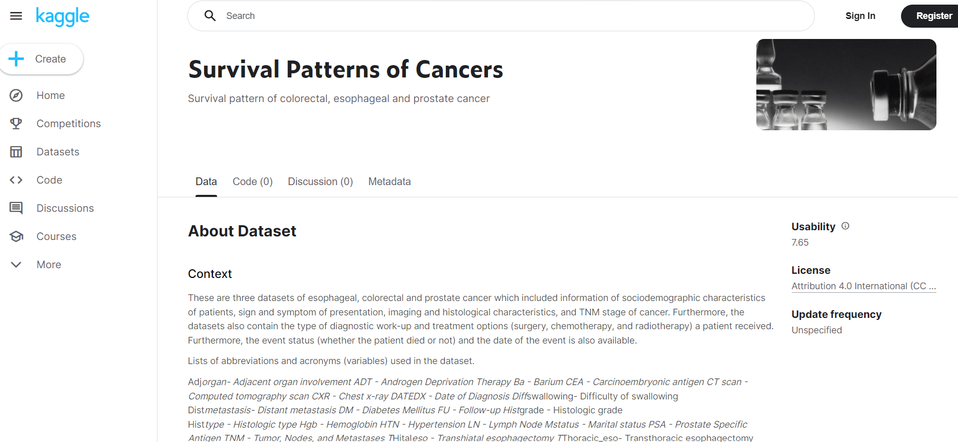
Data Clean up and Exploration

Slide 5
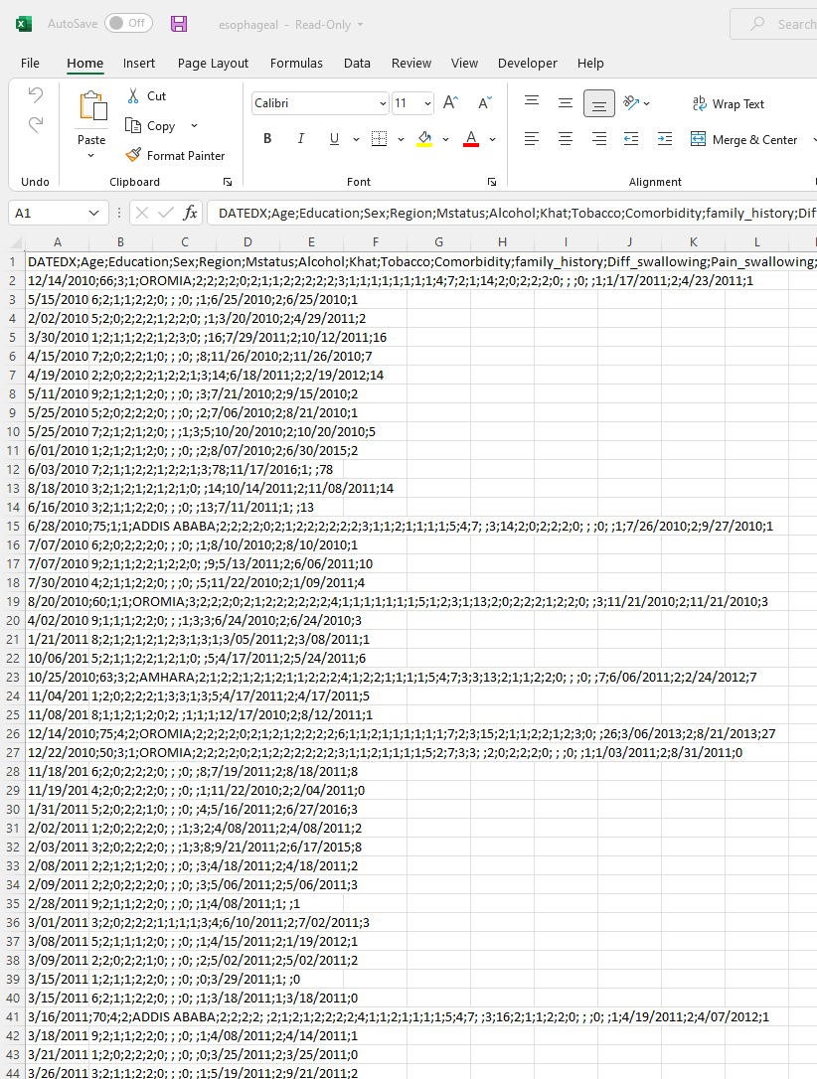
Data Clean up and Exploration

Slide 6
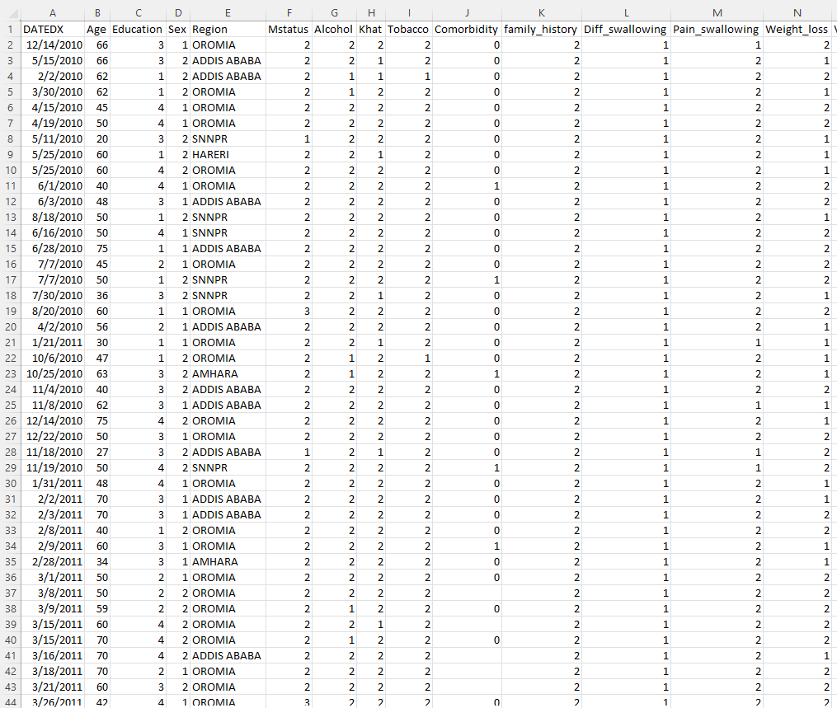
Data Clean up and Exploration

Slide 7

Analysis
We concluded that 59% of males died from cancer and 41% of females died from cancer. The most cases of cancer occurred in the region of Oromia. The most used drug that caused cancer was Khat which was 50% compared to Alcohol at 33% and Tobacco at 16.7%. There is a spike at 60 years old cancer patients and the average patients dead at 52 years old

Slide 8

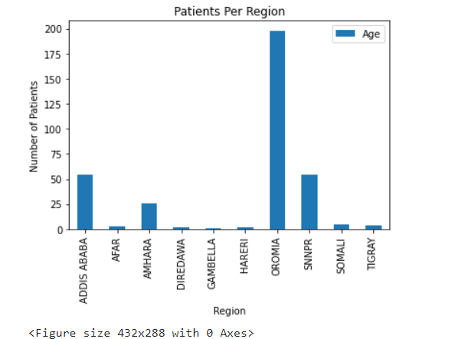
Region Analysis

Slide 9
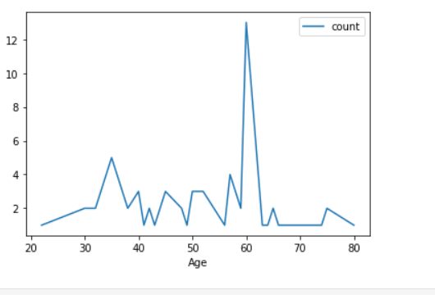
Age Analysis

Slide 10
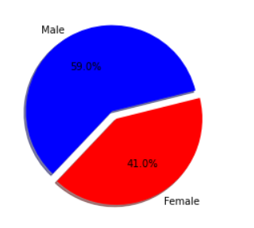
Gender Analysis

Slide 11
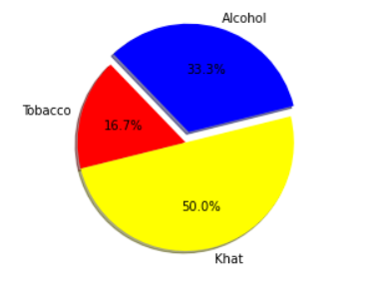
Drug Analysis

Slide 12
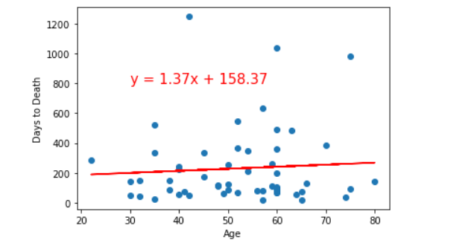
R2 Days to Death vs Age Analysis

Slide 13
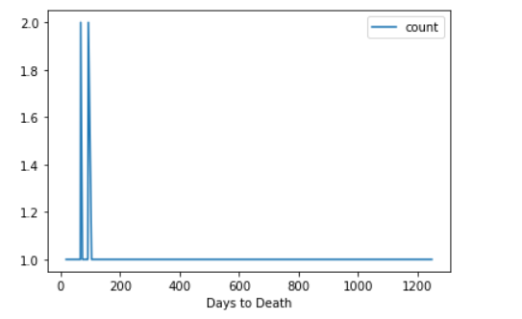
Days to Death Analysis

Slide 14
Discussion
We concluded that 59% of males died from cancer and 41% of females died from cancer. The most cases of cancer occurred in the region of Oromia. The most used drug that caused cancer was Khat which was 50% compared to Alcohol at 33% and Tobacco at 16.7%. There is a spike at 60 years old cancer patients and the average patients dead at 52 years old

Slide 15
Post mortem

Slide 16
Questions
Open- Floor Q&A with the audience

Slide 17


Thank You

